Slide 1

Individual Homework logic circuits
Șipoș Lucas George
Group 916/2

Slide 2

Problem Statement
Write a Boolean function of 4 variables given by its table of values, simplify it and draw the logic circuits corresponding to all its simplified forms.

Slide 3
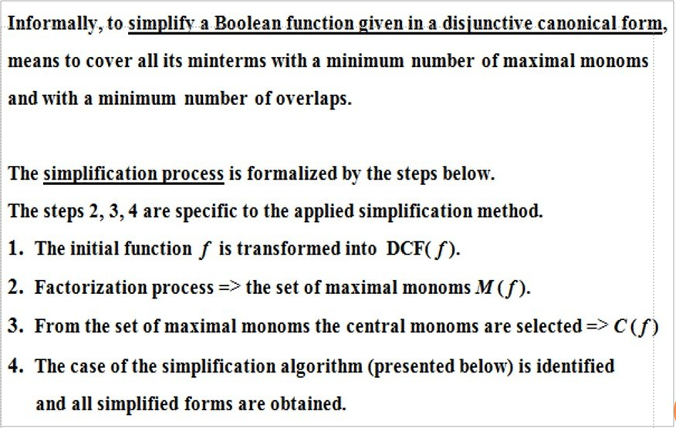
Theoretical Results - Simplifying

Slide 4
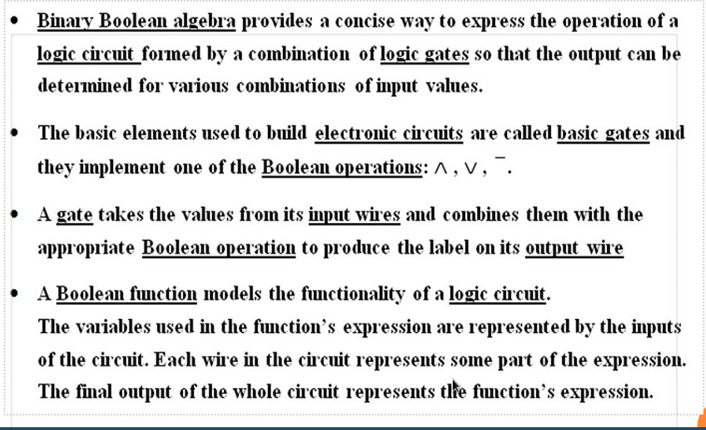
Theoretical Results - Circuits

Slide 5
Function Definition
X₁ | X₂ | X₃ | X₄ | /
0 | 0 | 0 | 0 | 0
0 | 0 | 0 | 1 | 1
0 | 0 | 1 | 0 | 1
0 | 0 | 1 | 1 | 0
0 | 1 | 0 | 0 | 0
0 | 1 | 0 | 1 | 1
0 | 1 | 1 | 0 | 0
0 | 1 | 1 | 1 | 1
1 | 0 | 0 | 0 | 0
1 | 0 | 0 | 1 | 1
1 | 0 | 1 | 0 | 1
1 | 0 | 1 | 1 | 0
1 | 1 | 0 | 0 | 0
1 | 1 | 0 | 1 | 0
1 | 1 | 1 | 0 | 0
1 | 1 | 1 | 1 | 1
Let / : (B₂)⁴ → B₂ be our Boolean function, defined by the table on the right.

Slide 6
Disjunctive Canonical Form
We search in the table for rows where the output value is 1, as those rows give us the support set of / :
S f ={(0, 0, 0, 1), (0, 0, 1, 0), (0, 1, 0, 1), (0, 1, 1, 1),
(1, 0, 0, 1), (1, 0, 1, 0), (1, 1, 1, 1)}
and the disjunctive canonical form:
/ (X₁, X₂, X₃, X₄) = X₁X₂X₃X₄ ∨ X₁X₂X₃X₄ ∨ X₁X₂X₃X₄ ∨ X₁X₂X₃X₄ ∨ X₁X₂X₃X₄ ∨ X₁X₂X₃X₄ ∨ X₁X₂X₃X₄
= m₁ ∨ m₂ ∨ m₅ ∨ m₇ ∨ m₉ ∨ m₁₀ ∨ m₁₅

Slide 7
Maximal And Central Monoms
From the Karnaugh map on the left we get the maximal and central monoms:
maX₁ = m₂ ∨ m₁₀
maX₂ = m₁ ∨ m₉
maX₃ = m₁ ∨ m₅
maX₄ = m₇ ∨ m₅
maX₅ = m₇ ∨ m₁₅
M ( / ) = {maX₁, maX₂, maX₃, maX₄, maX₅ }
C ( / ) = {maX₁, maX₂, maX₅ }
X₃X₄
 | 00 | 01 | 11 | 10
00 | 0 | m₁ | 0 | m₂
01 | 0 | m₅ | m₇ | 0
11 | 0 | 0 | m₁₅ | 0
10 | 0 | m₉ | 0 | m₁₀
X₁X₂

Slide 8
Maximal Monoms Simplification
maX₁ = m₂ ∨ m₁₀ = X₁X₂X₃X₄ ∨ X₁X₂X₃X₄ = X₂X₃X₄
maX₂ = m₁ ∨ m₉ = X₁X₂X₃X₄ ∨ X₁X₂X₃X₄ = X₂X₃X₄
maX₃ = m₁ ∨ m₅ = X₁X₂X₃X₄ ∨ X₁X₂X₃X₄ = X₁X₃X₄
maX₄ = m₇ ∨ m₅ = X₁X₂X₃X₄ ∨ X₁X₂X₃X₄ = X₁X₂X₄
maX₅ = m₇ ∨ m₁₅ = X₁X₂X₃X₄ ∨ X₁X₂X₃X₄ = X₂X₃X₄

Slide 9
Simplification
We are in the second case of the simplification algorithm, so let:
g(X₁, X₂, X₃, X₄) = maX₁ ∨ maX₂ ∨ maX₅
= X₂X₃X₄ ∨ X₂X₃X₄ ∨ X₂X₃X₄
There are two disjunctive simplified forms of / :
/₁^{DS} (X₁ , X₂ , X₃ , X₄) = g ∨ maX₃ = maX₁ ∨ maX₂ ∨ maX₅ ∨ maX₃
= X₂X₃X₄ ∨ X₂X₃X₄ ∨ X₂X₃X₄ ∨ X₁X₃X₄
/₂^{DS} (X₁ , X₂ , X₃ , X₄ ) = g ∨ maX₄ = maX₁ ∨ maX₂ ∨ maX₅ ∨ maX₄
= X₂X₃X₄ ∨ X₂X₃X₄ ∨ X₂X₃X₄ ∨ X₁X₂X₄

Slide 10
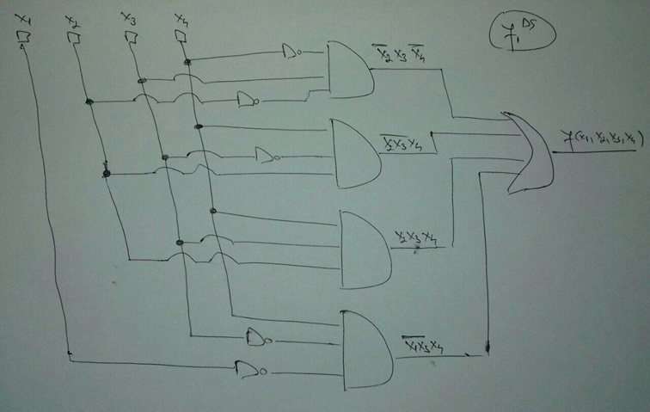

Slide 11
